Slide 1


MAWLANA BHASHANI SCIENCE AND TECHNOLOGY UNIVERSITY​ ​ DEPARTMENT OF COMPUTER SCIENCE AND ENGINEERING​

Slide 2
Welcome to our Presentation

Slide 3
Course:
CSE-2112 Software Development Project-I and Industrial Tour

Slide 4
Our Team
Wasif Bin Zahir
Fazle Rahat
CE-20022
CE-20023

Slide 5
Our Supervisor:
Mohammed Hadifur Rahman Sir
Associate Professor
Department of CSE, MBSTU

Slide 6
Project Title:
Digital Appointment System

Slide 7
Introduction:
Digital Appointment System is a medical application project meant for hospitals, clinical center, and diagnostic centers. This application is helpful for patient management in a hospital. Services of this application can digitize the whole patient management system of a particular hospital.

Slide 8
Key Features
01
02
03
04
05
Make an Appointment
Search an Appointment
Doctor Registration
Update details
Medical Test

Slide 9
Detailed features analysis:
Security system to prevent misuses (user login)
Patient appointment portal
Patient list browse
Specific Patient search
Deletion of record
Doctor Registration
Available doctors’ list
Searching doctor’s details
Medical Test
Searching medical test
Deletion of medical test

Slide 10
PROJECT OUTPUT & DESCRIPTION

Slide 11
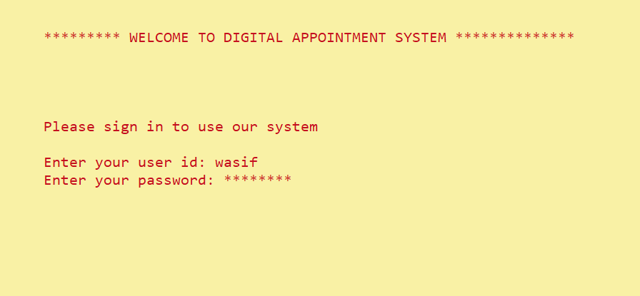
Log in System

Slide 12
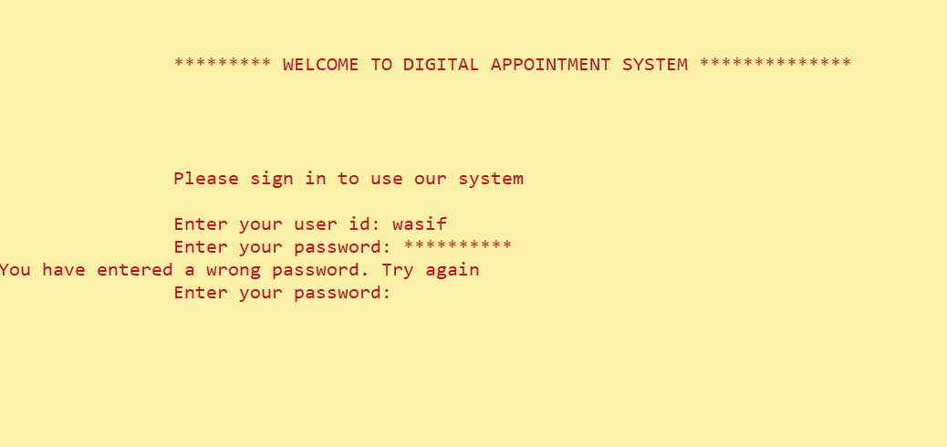
Security Checking
Showing a Warning for wrong password

Slide 13
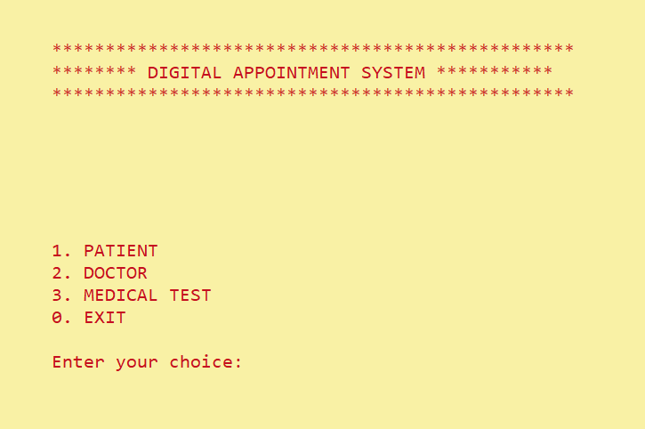

Slide 14
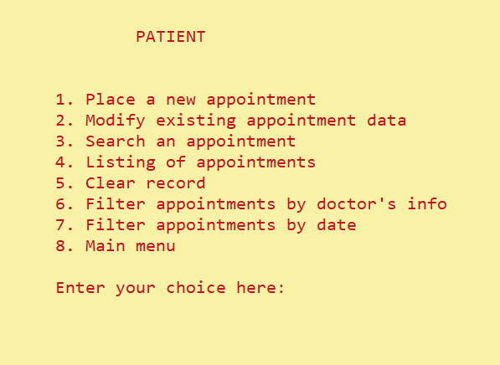

Slide 15
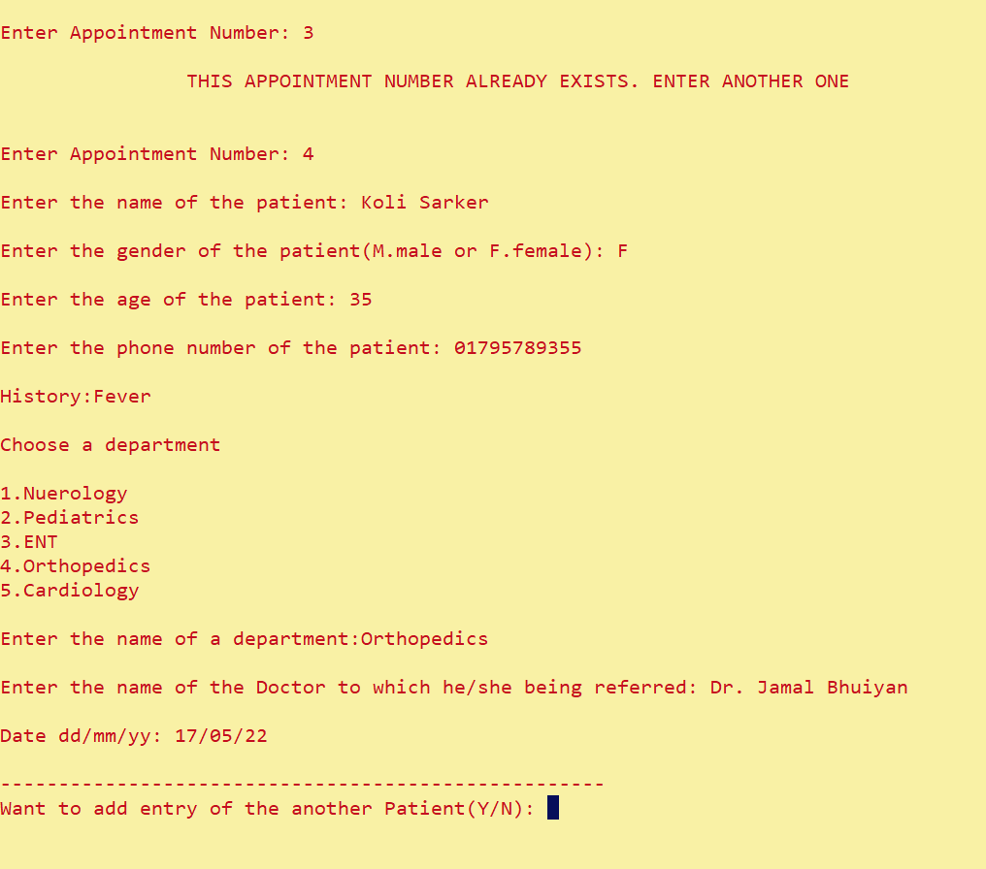
Asking for Another appointment
Checking for existing Serial

Slide 16
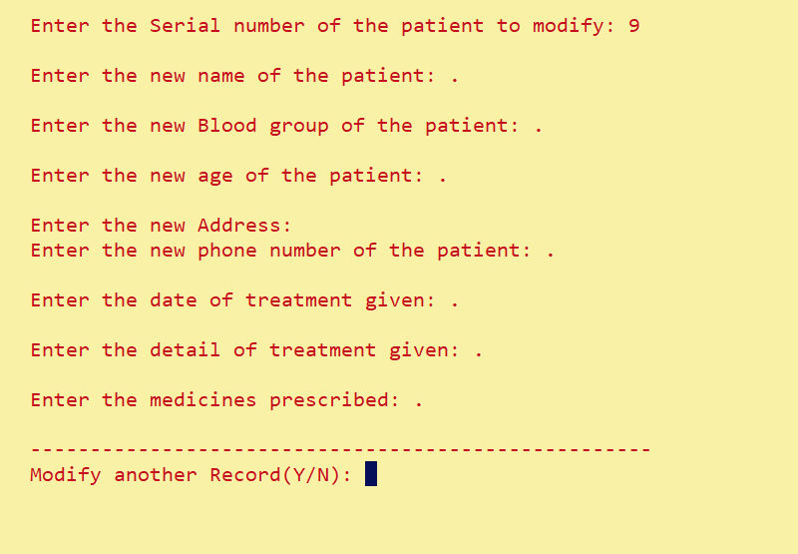
Update Patient Appointment

Slide 17
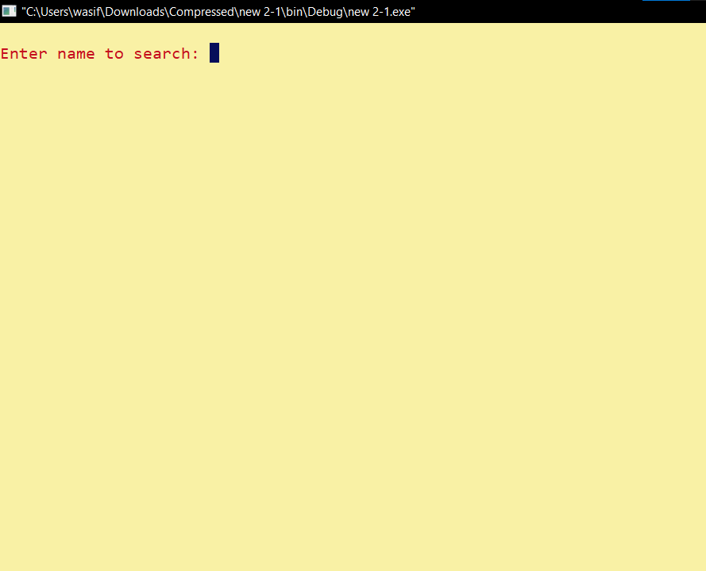
Search Patient Appointment

Slide 18
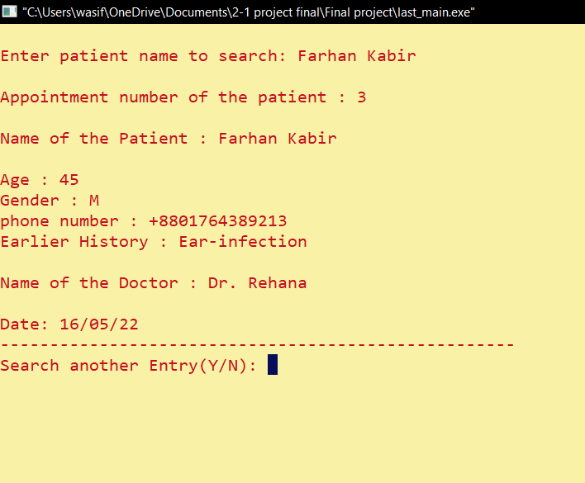
Patient Appointment Found

Slide 19
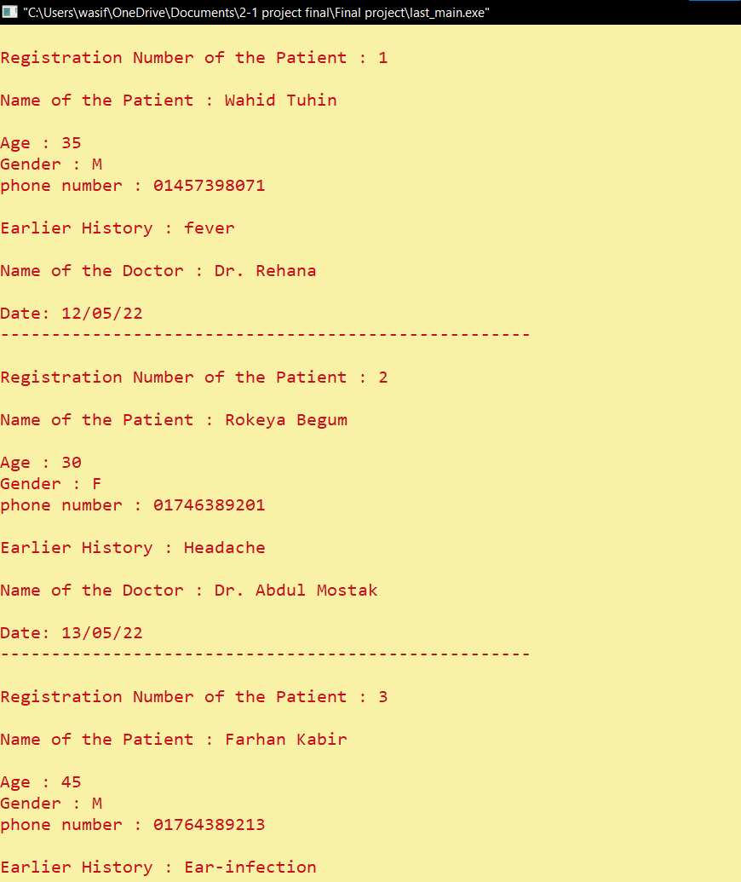
Patient Appointment List

Slide 20
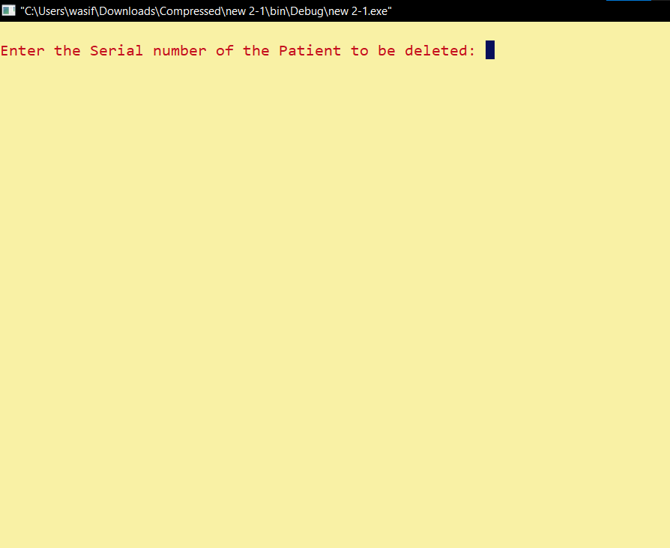
Patient Appointment Delete

Slide 21
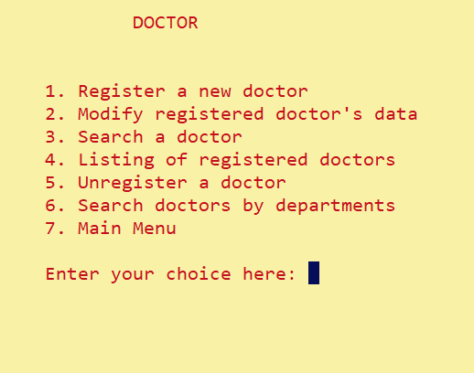

Slide 22
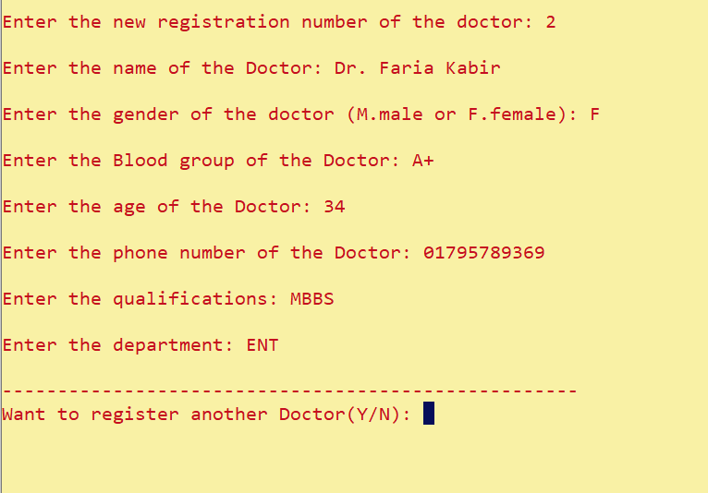
Registration

Slide 23
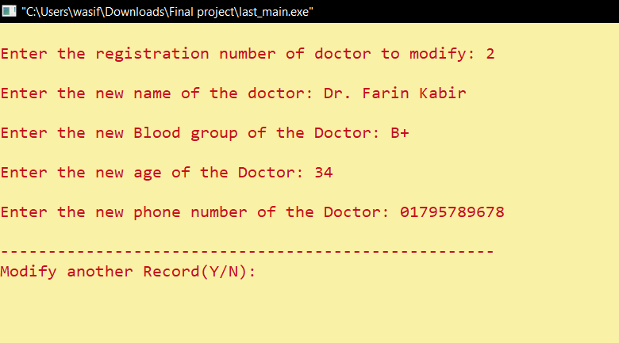
Modification

Slide 24
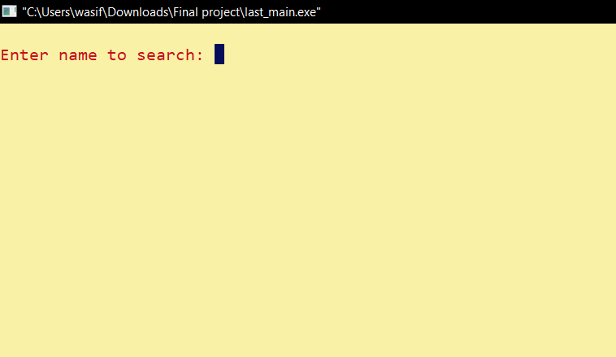
Doctor Search

Slide 25
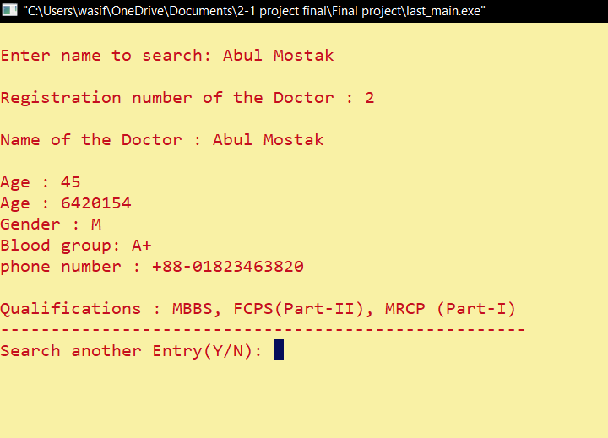

Slide 26
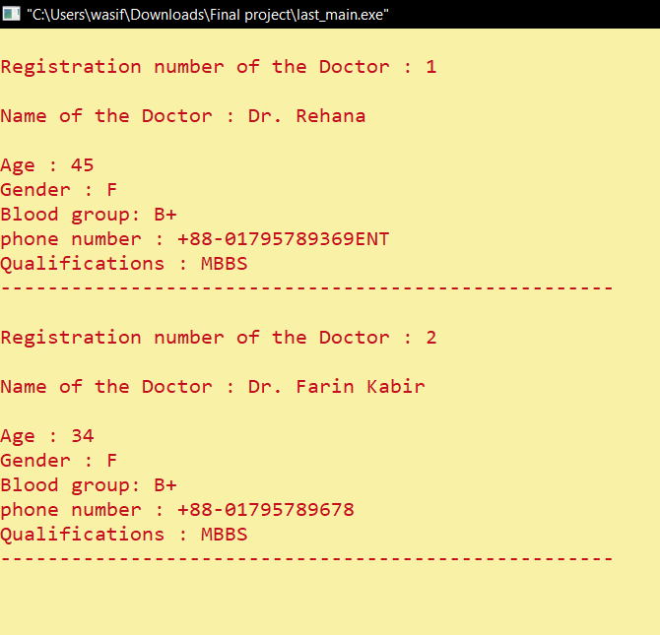

Slide 27
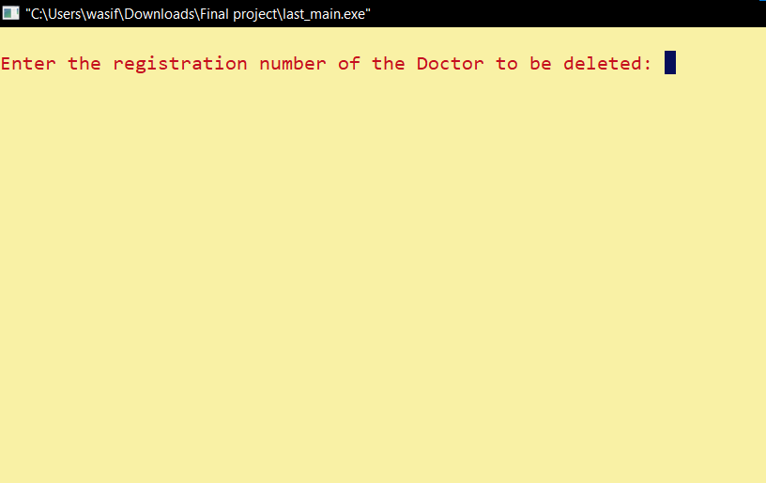

Slide 28
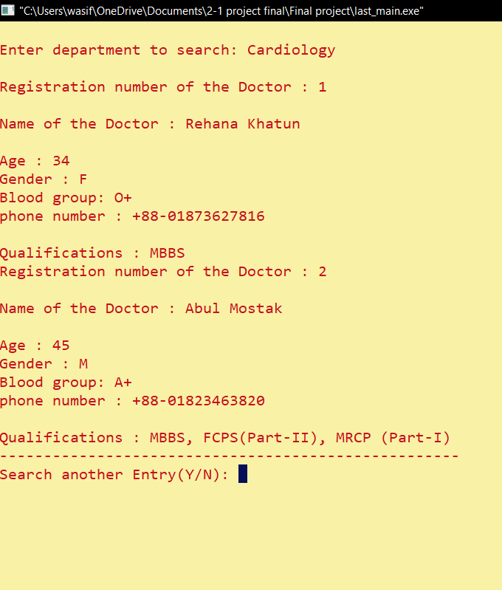

Slide 29
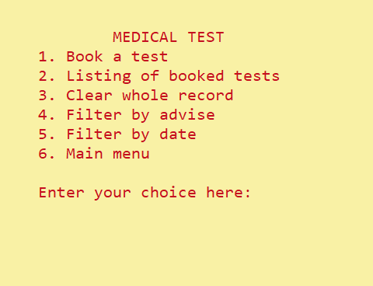

Slide 30
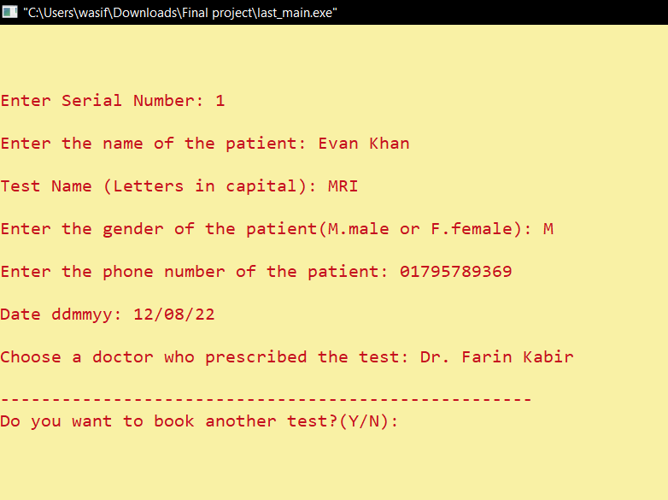

Slide 31
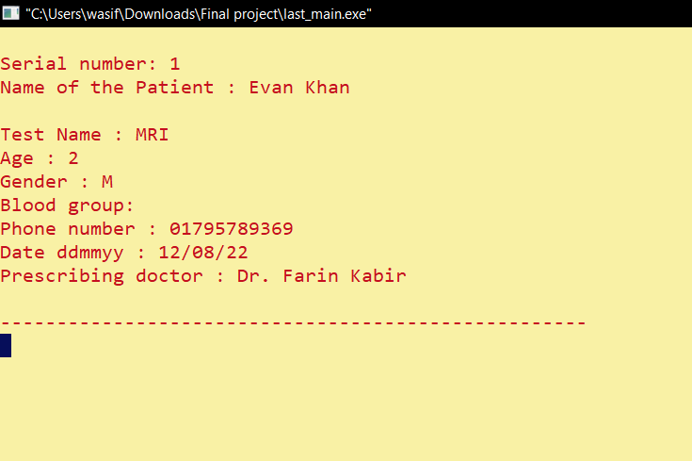

Slide 32
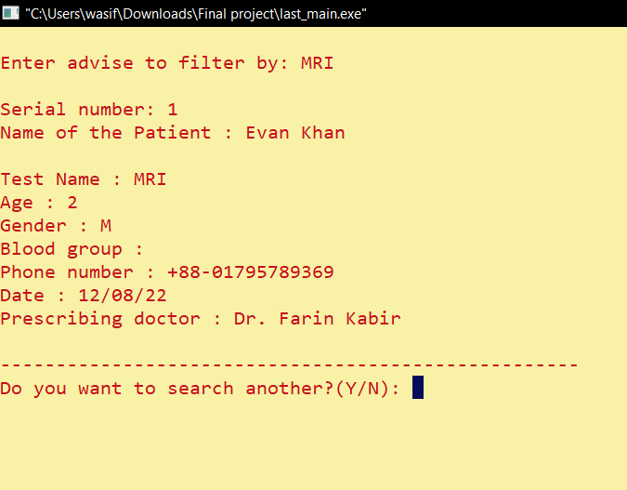

Slide 33
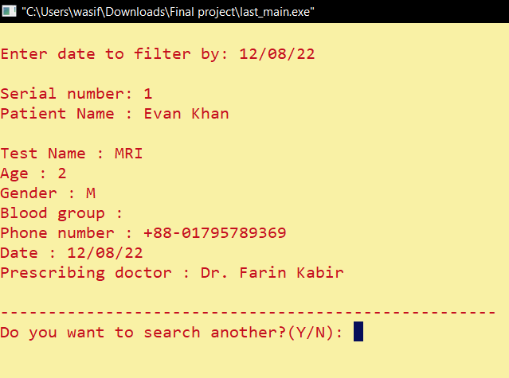

Slide 34
Key Resources
01
02
03
04
05
Struct
Functions
Files I/O
Loops
Arrays and Strings

Slide 35
Project Timeline
Phase 1
Phase 2
Phase 3
Phase 4
Team Discussion about the idea
Draft plan about the features
Coding
Code optimization for a better user experience

Slide 36
Limitations
01
02
03
No real-time online activity
Low graphical Interface
Can not handle an exception

Slide 37
Future Work
Real-time application
Online System
Full fledged Database
Better Graphical Interface
Patient End Appointment
Accounts

Slide 38
Work Distribution
Wasif Bin Zahir
Fazle Rahat
Coding-Patient Segment
Coding-Doctor Segment
Features Plan
Workflow Design
Presentation
Documentation

Slide 39
THANK YOU

